Slide 1
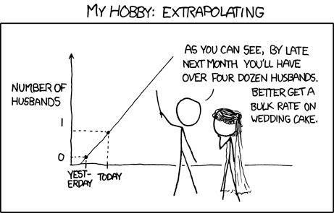
Assessing normality; Wilcoxon Tests
Geog4300/6300
Jerry Shannon

Slide 2
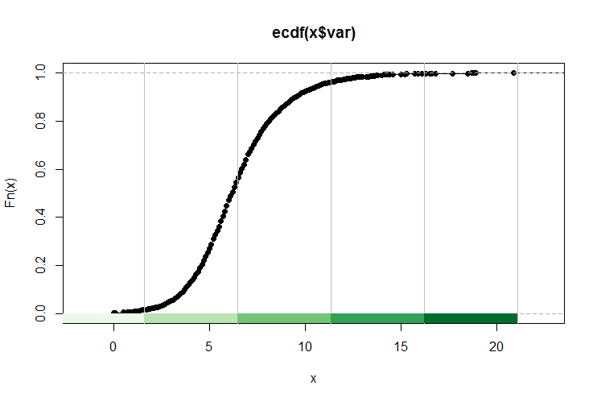
QQ plot: comparing % against actual value

Slide 3
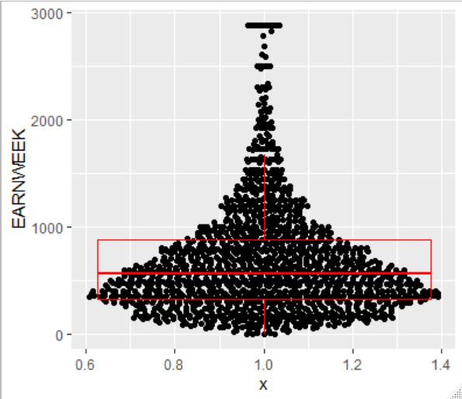
The EARNWEEK variable distribution
90th percentile
75th percentile
25th percentile
10th percentile

Slide 4
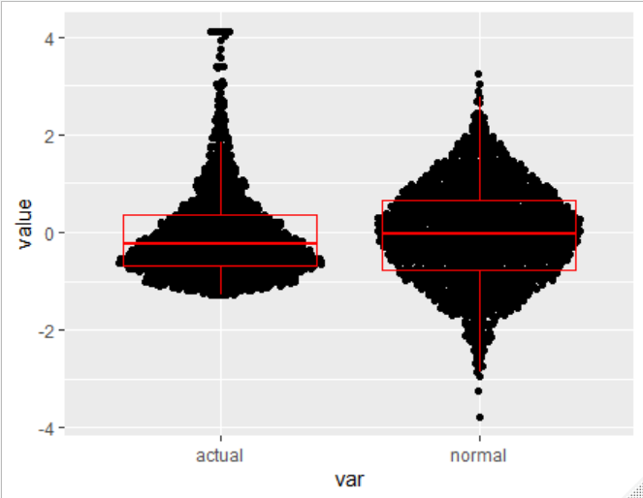
Compare an equivalent normal distribution
90th percentile
75th percentile
25th percentile
10th percentile

Slide 5
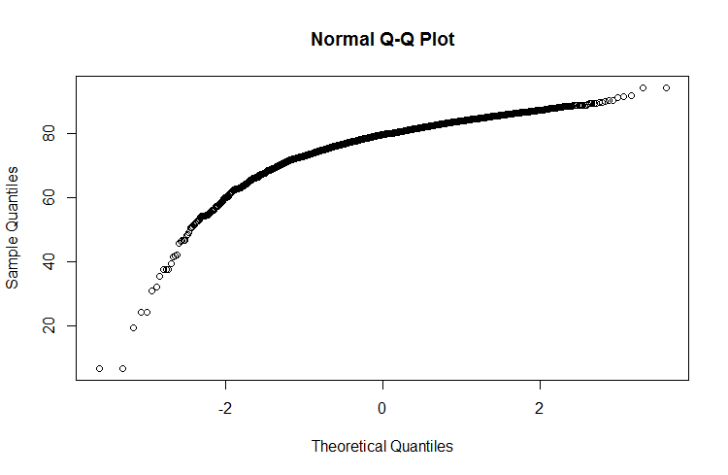
Testing normality with QQ plots
Comparing actual data with a normal distribution
% rank of actual data
Z score in a hypothetical
normal distribution

Slide 6
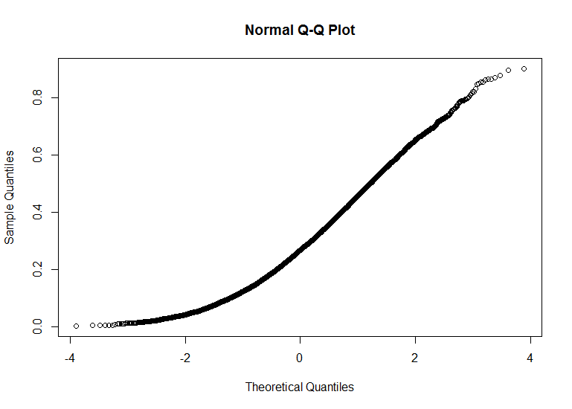
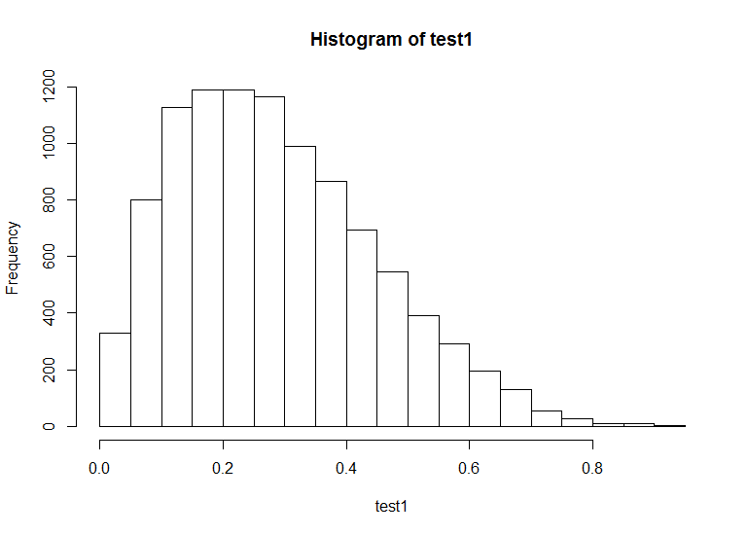

Slide 7
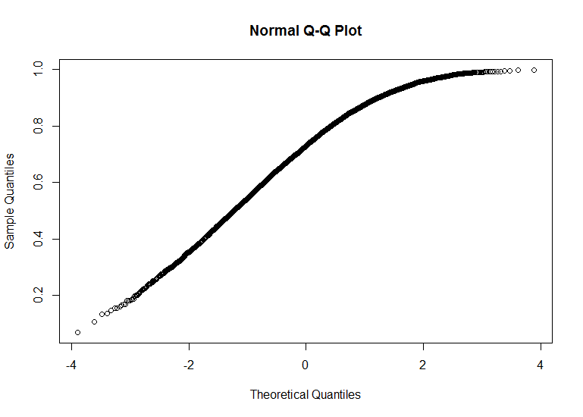
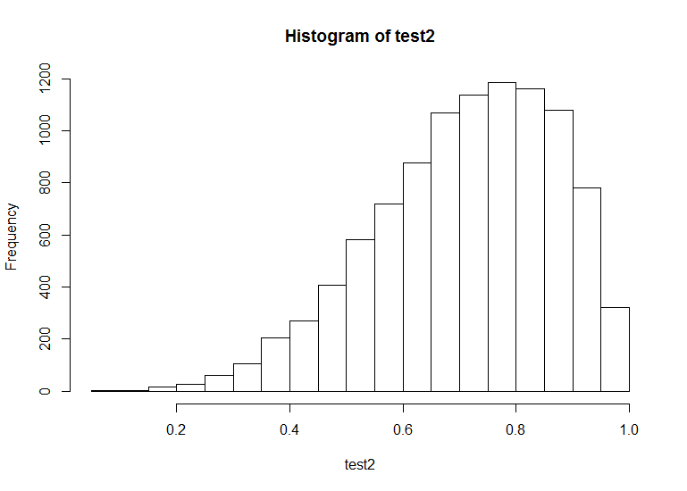

Slide 8
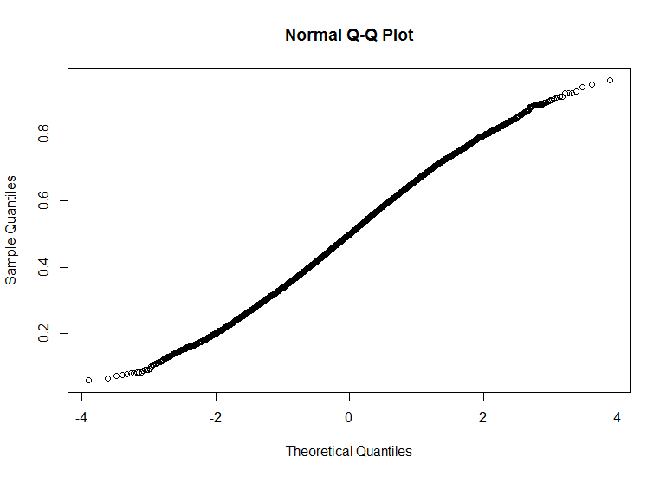
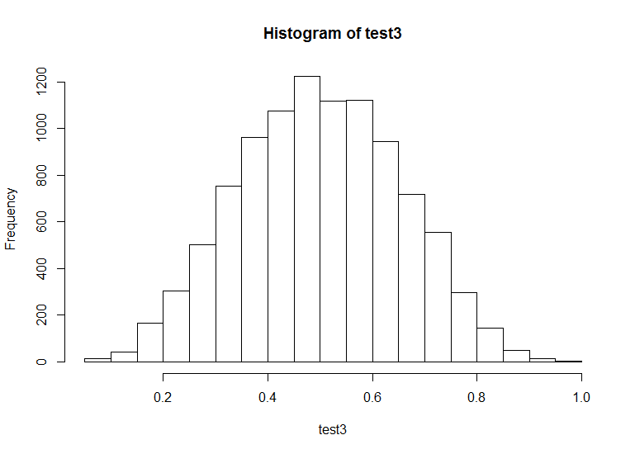

Slide 9
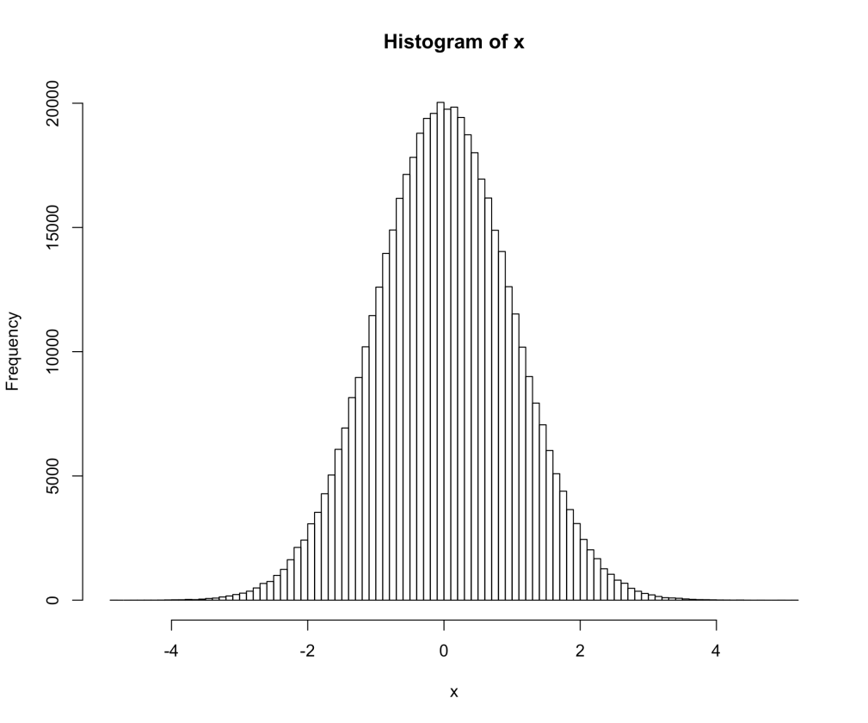
The Shaprio-Welk normality test compares the actual distribution to a normal distribution, measuring the gap between them at multiple points.
There are other normality test, but this one has more power when compared to other tests, especially with smaller (<50) samples.

Slide 10
Video break

Slide 11
What is a “parametric test”?
One where you assume the data is normally distributed.
Non-parametric tests transform the data in order to calculate a test statistic.

Slide 12
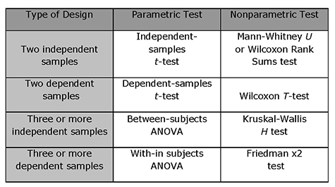

Slide 13
What if your samples aren’t normal?
Number of named Atlantic tropical storms, years
Random sample of hurricanes in El Nino and La Nina years—11 each
You need a non-parametric test with data that’s not normal.
El Nino | La Nina
0 | 4
5 | 4
1 | 12
3 | 2
4 | 17
1 | 7
2 | 6
2 | 10
0 | 4
2 | 8
4 | 6

Slide 14

What if your samples aren’t normal?
Wilcoxon tests are one common alternative.
Two tests:
Rank sum: alternative to two sample t-test
Matched-Pairs Signed-ranks: alternative to matched pairs test
Frank Wilcoxon
Speed demon and statistician

Slide 15
Wilcoxon Rank Sum test
Number of named Atlantic tropical storms, years
Question: Is the number of Atlantic storms significantly different in El Nino years compared to La Nina years?
El Nino | La Nina
0 | 4
5 | 4
1 | 12
3 | 2
4 | 17
1 | 7
2 | 6
2 | 10
0 | 4
2 | 8
4 | 6

Slide 16
Wilcoxon Rank Sum test
Number of named Atlantic tropical storms, years
Convert your data to ordinal ranks.
When tied, average the rank.
El Nino | La Nina
0 (1.5) | 4 (12)
5 (15) | 4 (12)
1 (3.5) | 12 (21)
3 (9) | 2 (6.5)
4 (12) | 17 (22)
1 (3.5) | 7 (18)
2 (6.5) | 6 (16.5)
2 (6.5) | 10 (20)
0 (1.5) | 4 (12)
2 (6.5) | 8 (19)
4 (12) | 6 (16.5)

Slide 17
Wilcoxon Rank Sum test
Number of named Atlantic tropical storms, years
El Nino | La Nina
0 (1.5) | 4 (12)
5 (15) | 4 (12)
1 (3.5) | 12 (21)
3 (9) | 2 (6.5)
4 (12) | 17 (22)
1 (3.5) | 7 (18)
2 (6.5) | 6 (16.5)
2 (6.5) | 10 (20)
0 (1.5) | 4 (12)
2 (6.5) | 8 (19)
4 (12) | 6 (16.5)
Then sum the ranks in each column.
If the two columns are equal, the ranks should also be equal.
W₁ = 77.5 W₂ = 175.5

Slide 18
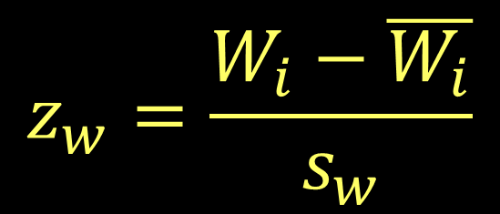
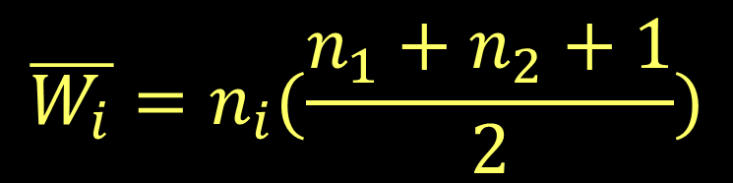
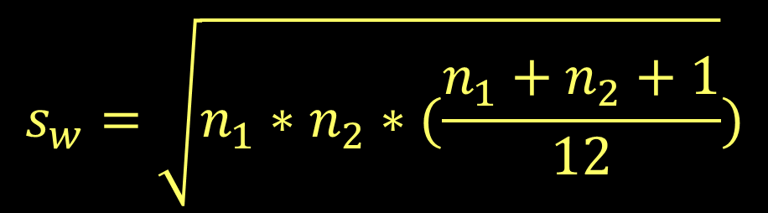
Wilcoxon Rank Sum test
Compare the observed rank sum to that we’d expect if the two groups were equal
W statistic for sample i
This statistic is a normal distribution

Slide 19
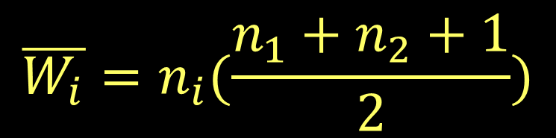
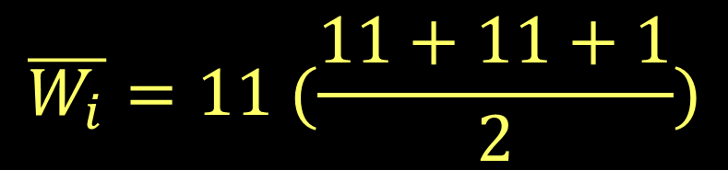

Wilcoxon Rank Sum test
Number of named Atlantic tropical storms, years
El Nino | La Nina
0 (1.5) | 4 (12)
5 (15) | 4 (12)
1 (3.5) | 12 (21)
3 (9) | 2 (6.5)
4 (12) | 17 (22)
1 (3.5) | 7 (18)
2 (6.5) | 6 (16.5)
2 (6.5) | 10 (20)
0 (1.5) | 4 (12)
2 (6.5) | 8 (19)
4 (12) | 6 (16.5)
W₁ = 77.5 W₂ = 175.5

Slide 20
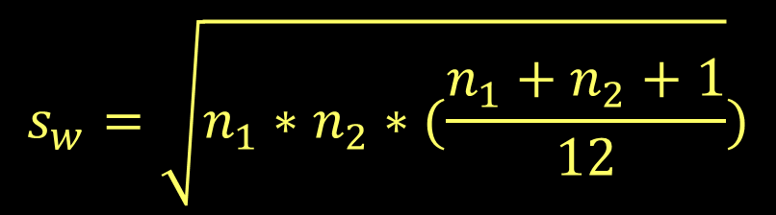
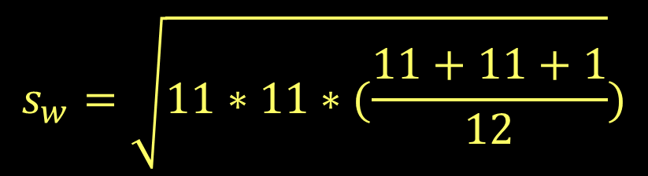

Wilcoxon Rank Sum test
Number of named Atlantic tropical storms, years
El Nino | La Nina
0 (1.5) | 4 (12)
5 (15) | 4 (12)
1 (3.5) | 12 (21)
3 (9) | 2 (6.5)
4 (12) | 17 (22)
1 (3.5) | 7 (18)
2 (6.5) | 6 (16.5)
2 (6.5) | 10 (20)
0 (1.5) | 4 (12)
2 (6.5) | 8 (19)
4 (12) | 6 (16.5)
W₁ = 77.5 W₂ = 175.5

Slide 21
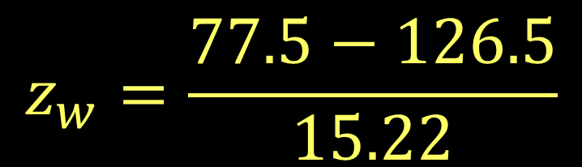

Wilcoxon Rank Sum test
Number of named Atlantic tropical storms, years
El Nino | La Nina
0 (1.5) | 4 (12)
5 (15) | 4 (12)
1 (3.5) | 12 (21)
3 (9) | 2 (6.5)
4 (12) | 17 (22)
1 (3.5) | 7 (18)
2 (6.5) | 6 (16.5)
2 (6.5) | 10 (20)
0 (1.5) | 4 (12)
2 (6.5) | 8 (19)
4 (12) | 6 (16.5)
Shows a significant difference between years
W₁ = 77.5 W₂ = 175.5

Slide 22
Wilcoxon Matched Pairs Signed-Ranks test
Non-parametric version of a matched pairs test
Goal is to compare changes in rank between matched samples
Question: Did the rank of this region’s cities change significantly?
 | 2000 | 2010
A | 3 | 6
B | 11 | 12
C | 9 | 8
D | 14 | 18
E | 17 | 15
F | 7 | 13
G | 21 | 25
H | 13 | 9
I | 19 | 24
J | 5 | 10
Regional cities’ national rank for population growth in previous 10 years

Slide 23
Wilcoxon Matched Pairs Signed-Ranks test
First find the absolute difference in ranks
Then assign ranks—averaging any ties.
 | 2000 | 2010 | Diff
A | 3 | 6 | 3 (4)
B | 11 | 12 | 1 (1.5)
C | 9 | 8 | 1 (1.5)
D | 14 | 18 | 4 (6)
E | 17 | 15 | 2 (3)
F | 7 | 13 | 6 (10)
G | 21 | 25 | 4 (6)
H | 13 | 9 | 4 (6)
I | 19 | 24 | 5 (8.5)
J | 5 | 10 | 5 (8.5)

Slide 24
Wilcoxon Matched Pairs Signed-Ranks test
Sum all positive ranks
(where 2000 > 2010)
And sum all negative ranks
 | 2000 | 2010 | Diff
A | 3 | 6 | 3 (4)
B | 11 | 12 | 1 (1.5)
C | 9 | 8 | 1 (1.5)
D | 14 | 18 | 4 (6)
E | 17 | 15 | 2 (3)
F | 7 | 13 | 6 (10)
G | 21 | 25 | 4 (6)
H | 13 | 9 | 4 (6)
I | 19 | 24 | 5 (8.5)
J | 5 | 10 | 5 (8.5)
T_{p} is the sum of positive ranks (C, E, H): 10.5
T_{n} is the sum of negative ranks (A, B, D, F, G, I, J): 44.5

Slide 25
Wilcoxon Matched Pairs Signed-Ranks test
For two tailed tests, use the smaller T (T_{p} here)
For one tailed tests, use the T that has less “members” (also T_{p} in this case—only 3 cities)
 | 2000 | 2010 | Diff
A | 3 | 6 | 3 (4)
B | 11 | 12 | 1 (1.5)
C | 9 | 8 | 1 (1.5)
D | 14 | 18 | 4 (6)
E | 17 | 15 | 2 (3)
F | 7 | 13 | 6 (10)
G | 21 | 25 | 4 (6)
H | 13 | 9 | 4 (6)
I | 19 | 24 | 5 (8.5)
J | 5 | 10 | 5 (8.5)
T_{p} is the sum of positive ranks (C, E, H): 10.5
T_{n} is the sum of negative ranks (A, B, D, F, G, I, J): 44.5

Slide 26
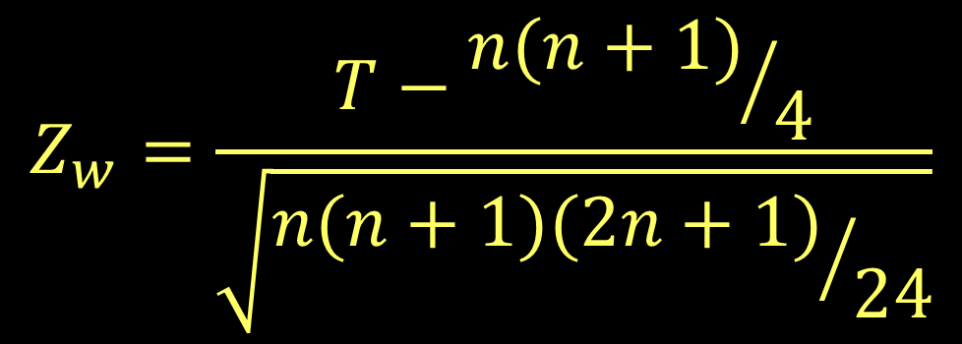
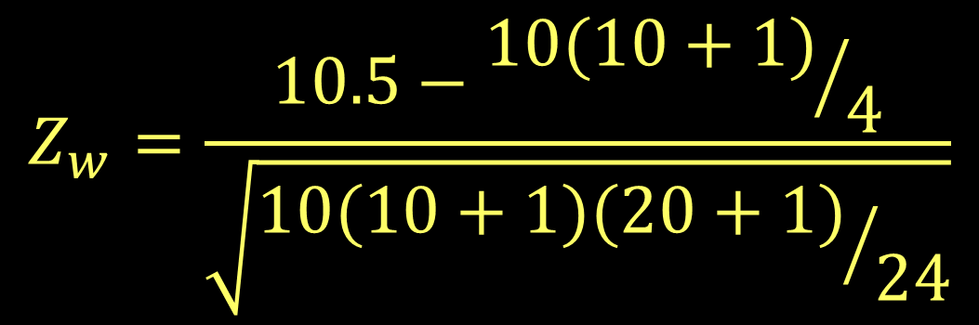


Wilcoxon Matched Pairs Signed-Ranks test

Slide 27
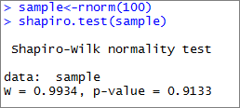

Wilcoxon and normality tests in R

